Slide 1

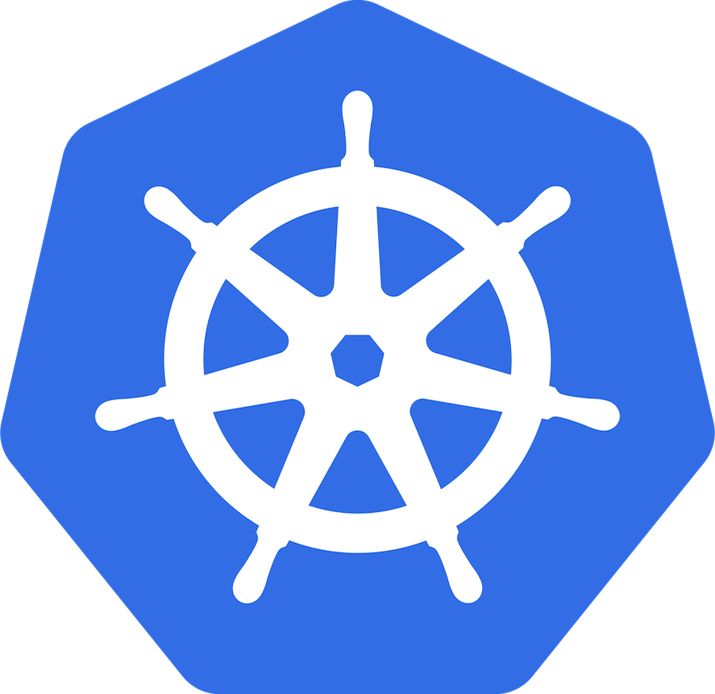
Apache Kafka on Kubernetes
Mateusz Dymiński

Slide 2
Apache Kafka on Kubernetes
Is Running Kafka on Kubernetes a Good Idea?
Kafka Storage in Kubernetes
Communication
Internal - How do clients run on K8s communicate with Brokers
External - How do external clients communicate with Brokers

Slide 3
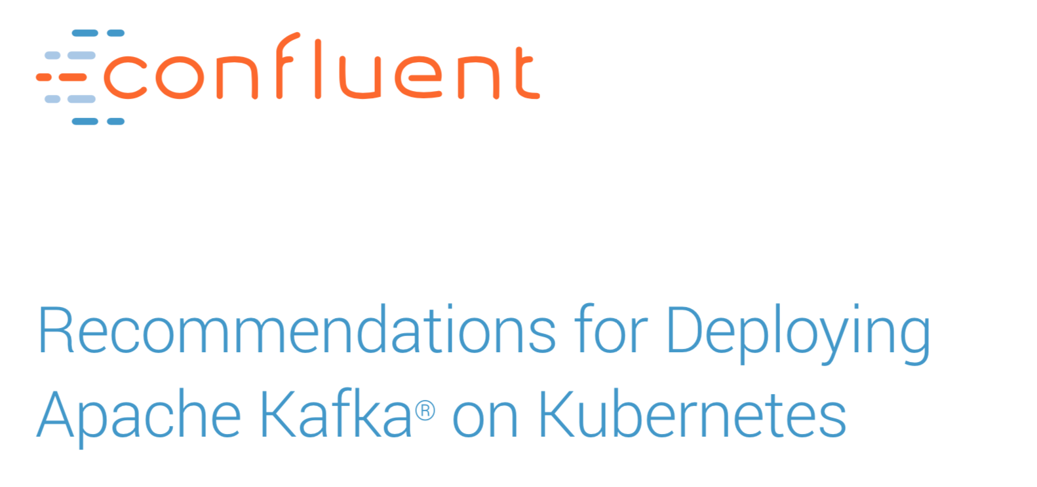
Source: https://www.confluent.io/resources/recommendations-for-deploying-apache-kafka-on-kubernetes

Slide 4

Is Running Kafka on Kubernetes a Good Idea?

Slide 5
Is Running Kafka on Kubernetes a Good Idea?
Don’t ask “Does it make sense to run Kafka on Kubernetes?”, ask “Do I want a standardized and automated way to manage an entire ecosystem of event-driven stream-processing services and their dependencies?”

Slide 6

Kafka storage on Kubernetes

Slide 7
Storage
Persistent of Ephemeral?
Zookeeper and Kafka Brokers - persistent
Kafka Connect, Kafka Streams, Schema registry etc – persistent is not that required
More explanations in next presentation

Slide 8
Storage
Local or Shared?
If you are deploying Kafka and Kubernetes in the cloud, this is an easy decision — use shared storage.
It is easier to:
configure and manage,
makes failure recovery faster and simpler and
shared storage on all large cloud providers has the throughput and latency required for successful Kafka deployments

Slide 9

Communication

Slide 10
Internal - How do clients run on K8s communicate with Brokers
The bootstrap.servers broker list can be just cp-kafka:9092
it doesn’t matter which broker responds with metadata.
But once you start producing and consuming, you need to communicate with specific brokers.
Each Broker has it’s own headless service
Each Service has it’s own DNS entry i.e. cp-kafka-1-headless:9092
If broker(pod) goes down, it will be recreated and the DNS name would be the same
advertised.listeners is responsible for configuration clients

Slide 11
External - How do clients communicate with Brokers
Producing and consuming messages requires to communicate with specific brokers
DNS outside of K8s cluster is not available
We have 3 options to expose each broker to the outside of the world:
NodePort
LoadBalancer
Ingress

Slide 12

Thanks!

